Slide 1
NEHEMIAH

Slide 2
NEHEMIAH
Nehemiah ~ "The Lord has Comforted"

Slide 3
NEHEMIAH
Earlier versions of the LXX and Vulgate called 2nd Ezra
Ezra/Nehemiah counted as one book in Tanakh

Slide 4
NEHEMIAH
“Mr. Gorbachev, tear down this wall!” – President Reagan
"Come and let us build the wall of Jerusalem, that we may no longer be a reproach.” – Nehemiah 2.17

Slide 5
NEHEMIAH
Xerxes I
Artaxerxes
470 BC
450 BC
430 BC
410 BC
Ezra Returns
458 BC
Nehemiah’s 1st term 444-432 BC
Nehemiah’s 2nd term begins 424 BC

Slide 6
NEHEMIAH
Ezra = spiritual aspects of return
Nehemiah = physical aspects of return

Slide 7
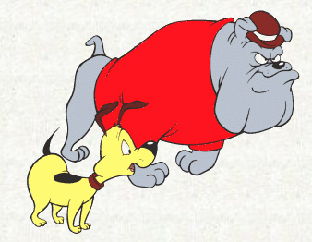
NEHEMIAH
Spike
Sanballat
Tobiah
Chester

Slide 8
NEHEMIAH
Tyropoeon Valley
Kidron Valley
Fish
Gate
Sheep
Gate
Miphkad Gate
Old
Gate
East
Gate
Valley
Gate
Horse
Gate
Hinnom Valley
Water
Gate
City of David
Fountain
Gate
Refuse
Gate
Walls in Nehemiah
Present Old City Walls
Temple Mount (NT)
.5 mi.

Slide 9
NEHEMIAH
And whatever you do in word or deed, do all in the name of the Lord Jesus, giving thanks to God the Father through Him.
Colossians 3.17

Slide 10
NEHEMIAH
A time to weep, And a time to laugh; A time to mourn, And a time to dance …
Ecclesiastes 3.4

